Slide 1
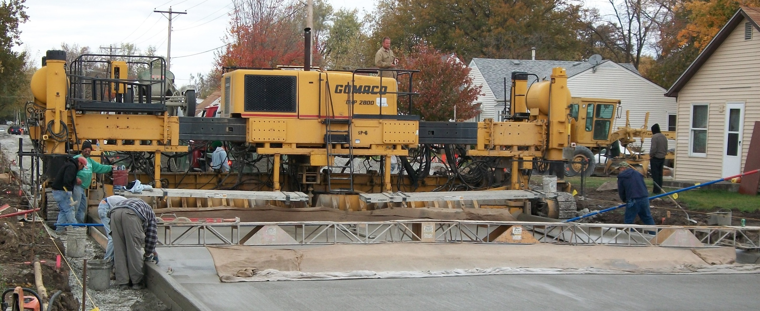
City of Ottumwa
Presentation on:
Street Reconstruction
Street Selection Process

Slide 2
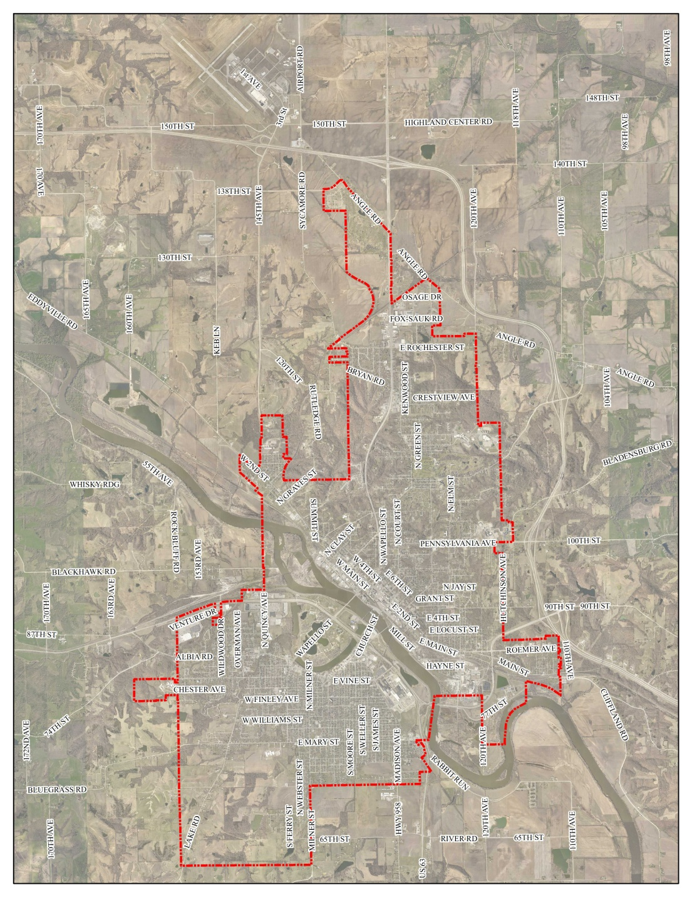
Background Information
The City of Ottumwa Corporate Limit encompasses an area of 16.65 Sq. Miles
The City of Ottumwa maintains:
320+ lane miles of hard surfaced streets
53+ miles of improved/unimproved alleys
158+ miles of Sanitary Sewer
76+ miles of Storm Sewer
3,704 manholes (as of last count)
3,673 intakes (as of last count)

Slide 3
Background Information
BUDGETING
The City runs on an annual budget of approximately $60 million
Heavy burden upon the City to support the EPA mandated Sewer Separation work
- Set Compliance Schedule (completion date of 2036)
- The total estimated cost of this effort is $160,000,000
- To date, the City has spent approximately $68,000,000.
Street Reconstruction/Resurfacing Budgets
- Road Use ($850,000)
- LOST ($1.2 million)
- CIP
- FY 15 = $1,990,000.00
- FY 17 = $2,790,312.00
- FY 19 = $3,100,000.00
($4 million- changes annually depending on Bonding cycle)

Slide 4
Goals of the Selection Process
- To preserve and/or improve the overall condition of city streets.
- To provide the best street condition for the largest number of drivers.
- To reduce maintenance costs.
- To use an objective and repeatable process.
- To coordinate street improvement in an efficient manner. The City runs on an annual budget of approximately $60 million

Slide 5
The Department of Public Works considers a number of factors when determining the highest priority streets for reconstruction or resurfacing. The first two important factors are the "Remaining Service Life" and the traffic volume (average daily traffic) of the street.
To maximize the benefits of the paving program, the City prioritizes the streets with the lowest remaining service life and the highest average daily traffic.
We utilize two standard methods, we first review the Iowa Pavement Management Program (IPMP) data which uses accurate past and projected pavement conditions to optimize cost effective decisions on roadway maintenance. (See attached example). This information along with visual inspection are used when selecting streets.

Slide 6
We then take into account recently completed work and future work including municipal and utility work. We then overlay our current federally mandated 25 year compliance schedule for areas of future known separation. In these areas the streets are deferred until the area is in the design stages.
As part of the detailed assessment process we review the condition of the sanitary sewer to determine if rehabilitation or replacement is required, this step dictates if resurfacing is possible or complete replacement is required.
We then review water main break history and coordinate with OWW for main replacement consideration. If the design will allow we locate new mains outside of pavement areas.

Slide 7
We then review all funding options to determine funding levels for each street classifications. One important factor to note is each funding source has specific uses and can be used on specific project types or street classifications. An example would be Statewide Transportation Improvement Program (STIP) programed on minor arterials such as, Milner Street (Burrhus to Mary) or Main Street (Jeff to Vine) or the Traffic Safety Transportation Improvement Program (TSIP) used for improvements on the Richmond & Ferry and Albia Rd & Wapello Street intersections.
Once needs are determined and local funding option identified we review if any grant funds are possible matches. Street Replacement project schedules can be dependent on grant awards and have been delayed to be in a position to receive funds. An example is the Market Street Bridge which was listed for eight years before we were awarded $1,000,000 dollars.

Slide 8
Other outside factors that have to be considered are plans from Community organizations such as Main Street Iowa and Legacy Foundation. Often these plans include infrastructure needs that the City is identified as a funding partner.
As with most municipalities our infrastructure needs far exceed our revenues sources.
Once streets are selected we finalize a project list with estimates and submit for council’s final selection and approval.

Slide 9
Criteria for Street Resurfacing
The City uses a process that takes a number of factors into consideration before selecting streets to be improved. These factors include:
1.) Sewer Separation 25 year compliance schedule
2.) Sewer Main condition
3.) Water main condition and break history
4.) Street Classifiaction
- Minor Arterial
- Collector
- Local
- alley
5.) Traffic Volumes (may determine types of funding available)
- Standard Traffic counts
- Truck Counts

Slide 10
6.) Traffic Type
- Pedestrian
- Trails
- Auto
- Heavy truck
7.) Existing Street surface condition
- Type of Surface (PCC/HMA)
- Traffic Volumes (may determine types of funding available)
- Standard Traffic counts
- Truck Counts
8.) Type of Structure
- Urban Sections
- Rural Sections
9.) Change of Use
- Development Driven
10.) Emergency repair
- Utility failures (water mains/sewer mains)

Slide 11
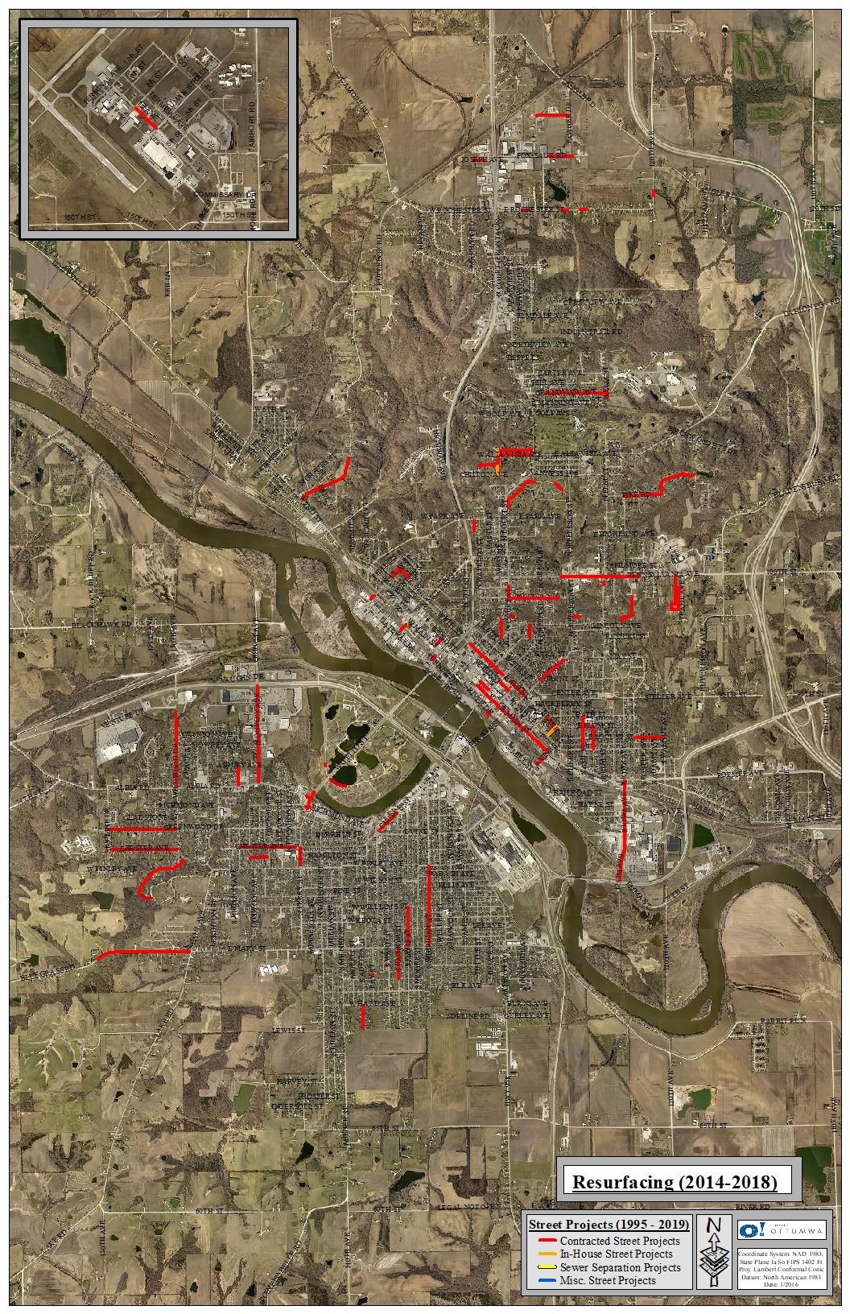
Past Street Work
2014 to 2018 (5 years)
TOTAL STREET RESURFACING PROJECTS FROM 2014 TO 2018 (5 YEARS)
- 23.1 lane miles of street have been reconstructed or resurfaced through contracted projects at a cost of over $15.6 million.

Slide 12
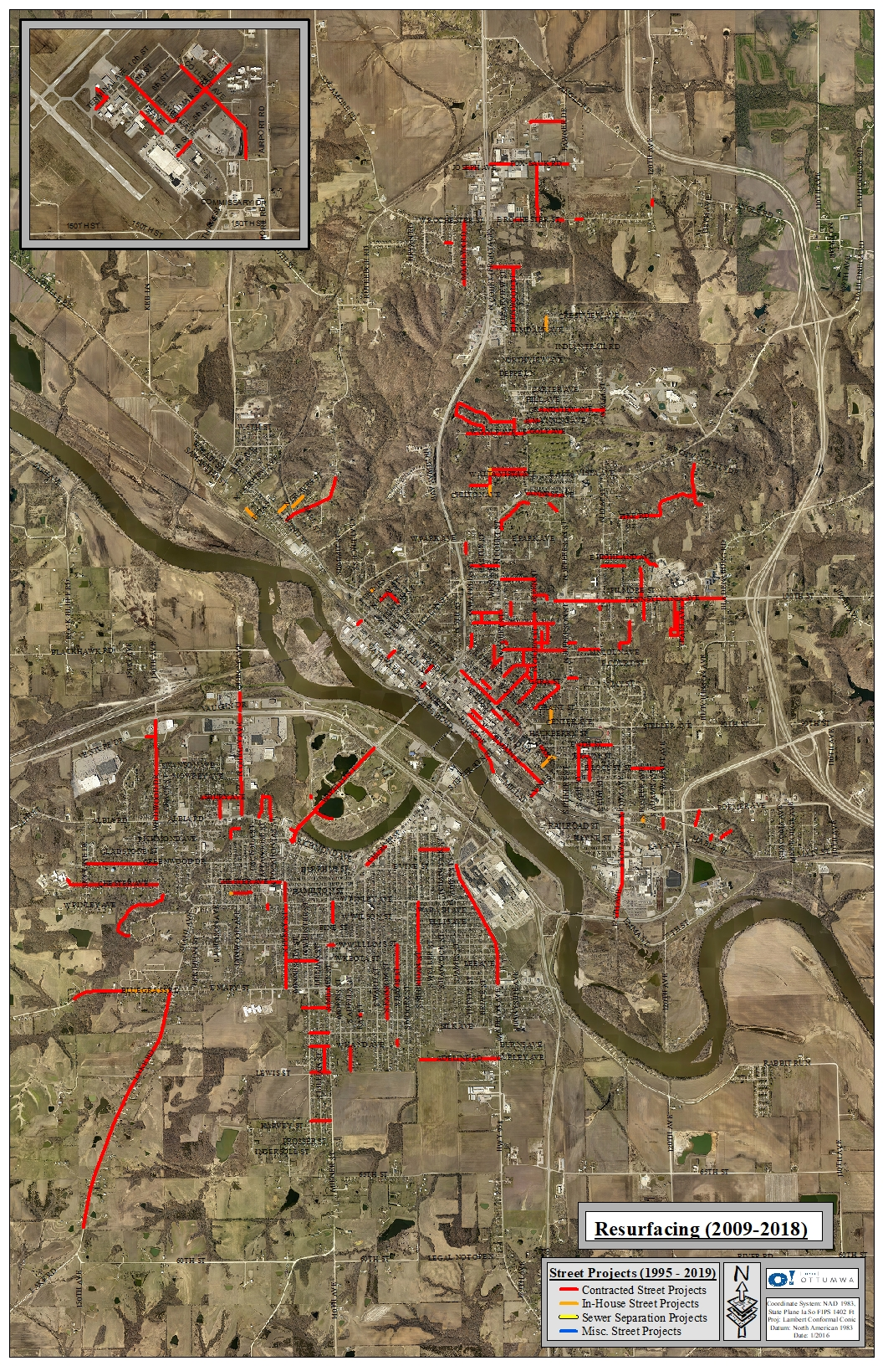
Past Street Work
2009 to 2018 (10 years)
TOTAL STREET RESURFACING PROJECTS FROM 2009 TO 2018 (10 YEARS)
- 59.2 lane miles of street have been reconstructed or resurfaced through contracted projects at a cost of over $28.1 million.

Slide 13
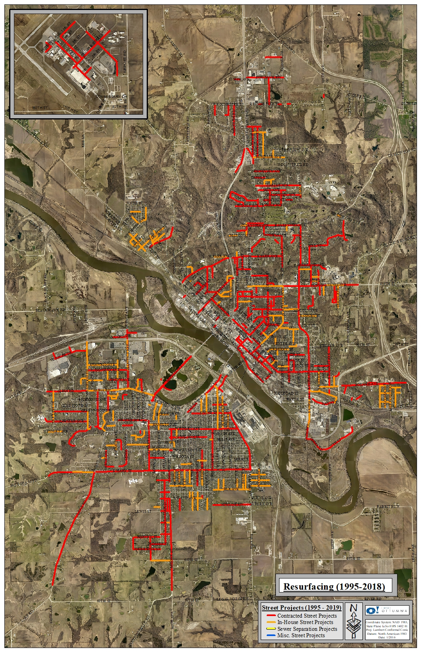
Past Street Work
1995 to 2018 (24 years)
CONTRACTED PROJECTS
- 116.3 lane miles of street have been reconstructed or resurfaced through contracted projects at a cost of over $41 million.
IN HOUSE PROJECTS
- 52.4 lane miles of streets have been reconstructed or resurfaced through In-House projects at a cost of over $6 Million.
TOTALS (1995 to 2018)
= 168.7 lane miles
= $47 million

Slide 14
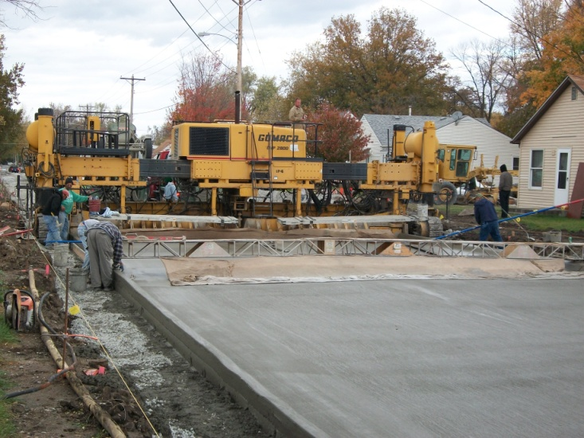
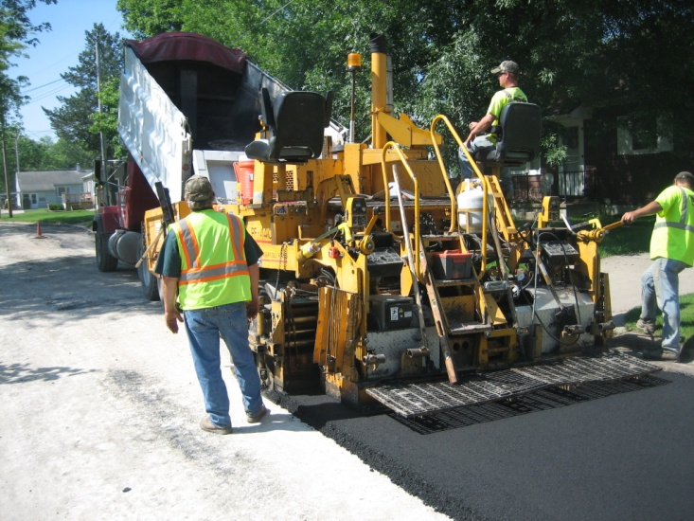
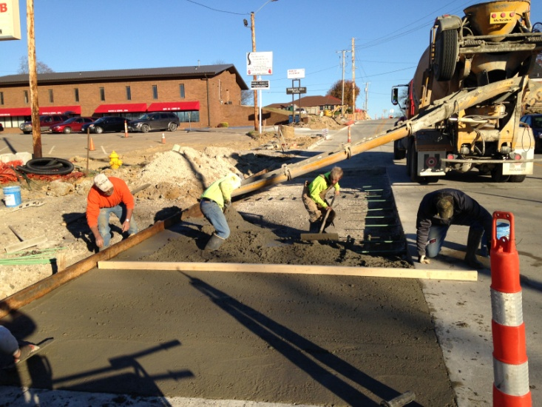
Street Reconstruction/Resurfacing
On an annual basis, the City of Ottumwa manages various Street Reconstruction and Resurfacing Projects. Project types include:
1.) Full Width, Full Depth PCC Reconstruction Projects
2.) Hot Mix Asphalt Overlay projects
3.) Street patching following underground utility work

Slide 15
Street Reconstruction/Resurfacing
1.) Full Width, Full Depth PCC Reconstruction Projects
Full Width, Full Depth PCC Reconstruction typically includes:
- Full utility replacement including
a.) Sanitary Sewer
b.) Storm Sewer
c.) Water Main
d.) private utilities as necessary (electrical, gas, cable, etc.)
- Designed to meet current Street Design Standards
- Includes complete subbase preparation
- 30 year design life
** This type of project is generally funded in part through a Grant.

Slide 16
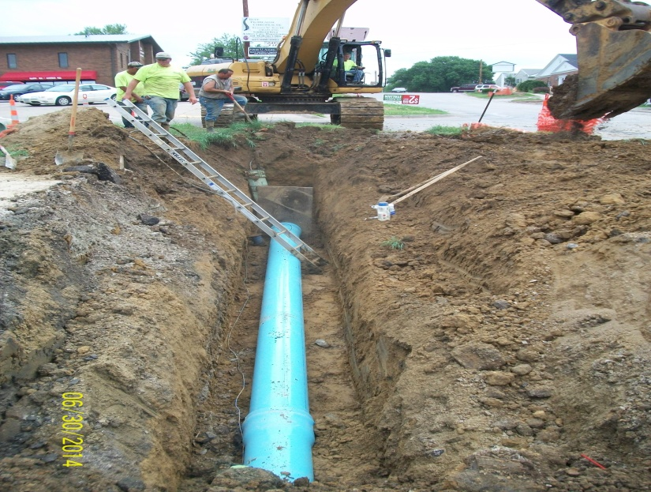
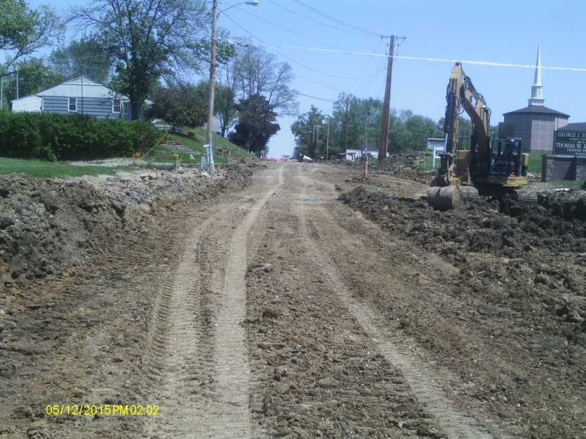
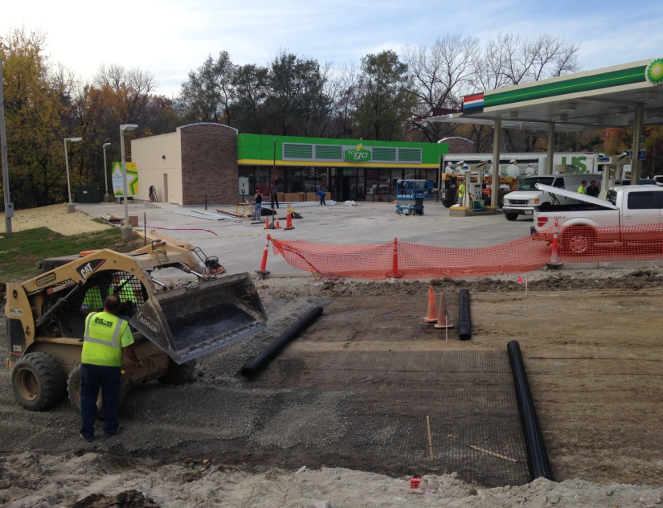
Street Reconstruction/Resurfacing
1.) Full Width, Full Depth PCC Reconstruction Projects

Slide 17
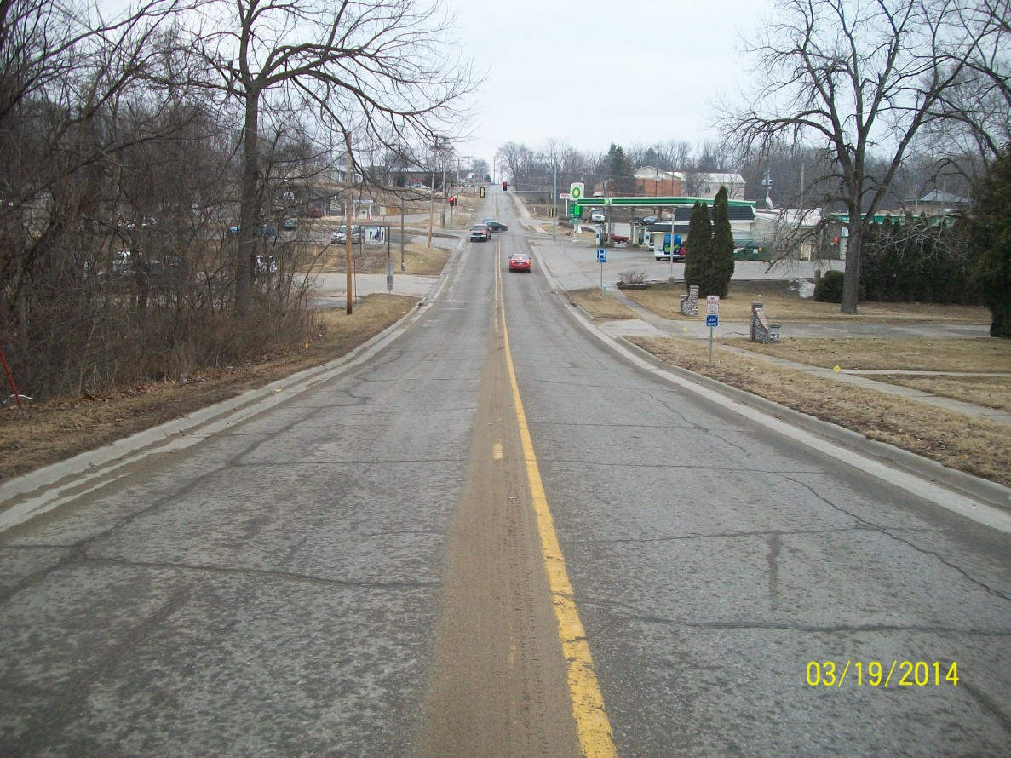
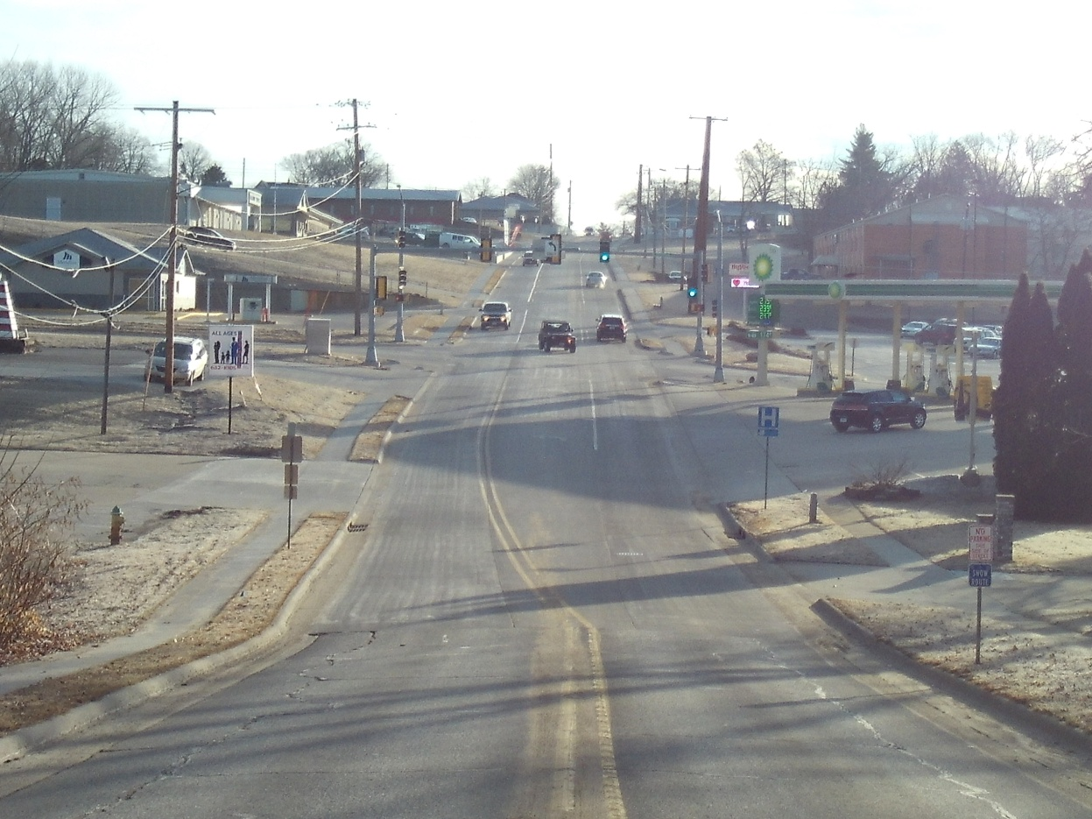
Street Reconstruction/Resurfacing
1.) Full Width, Full Depth PCC Reconstruction Projects
After
Before

Slide 18
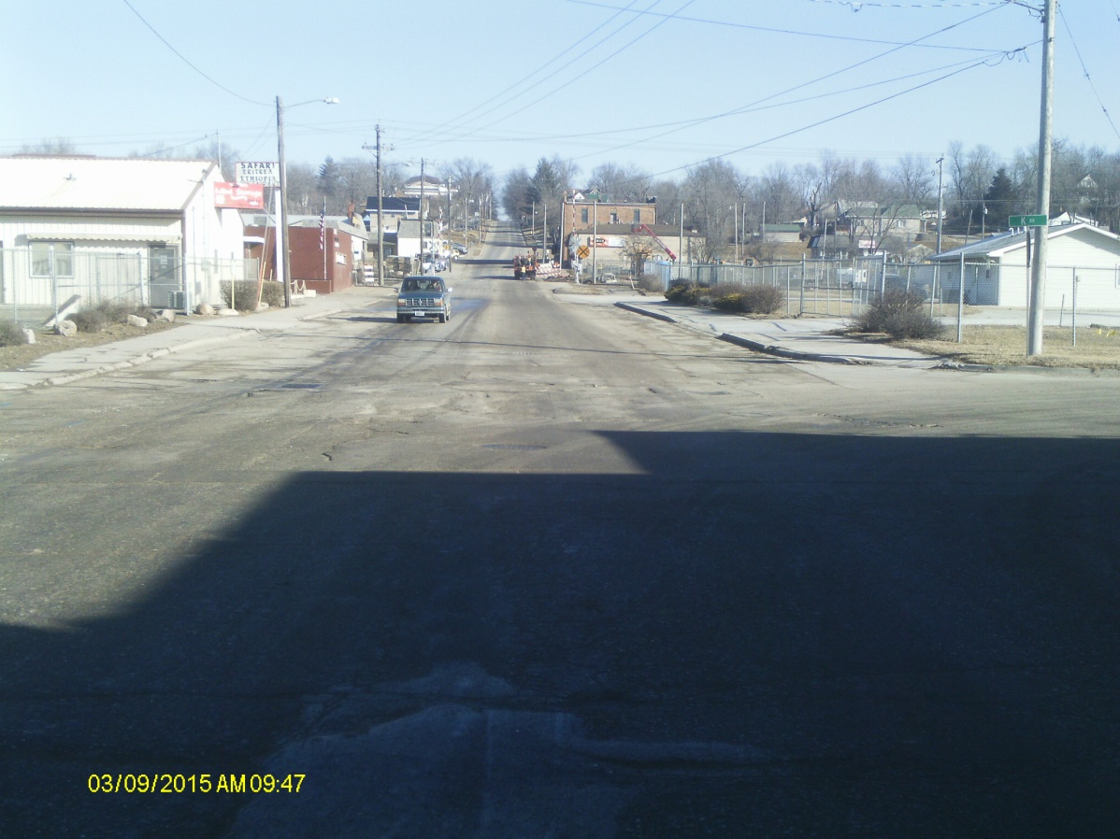
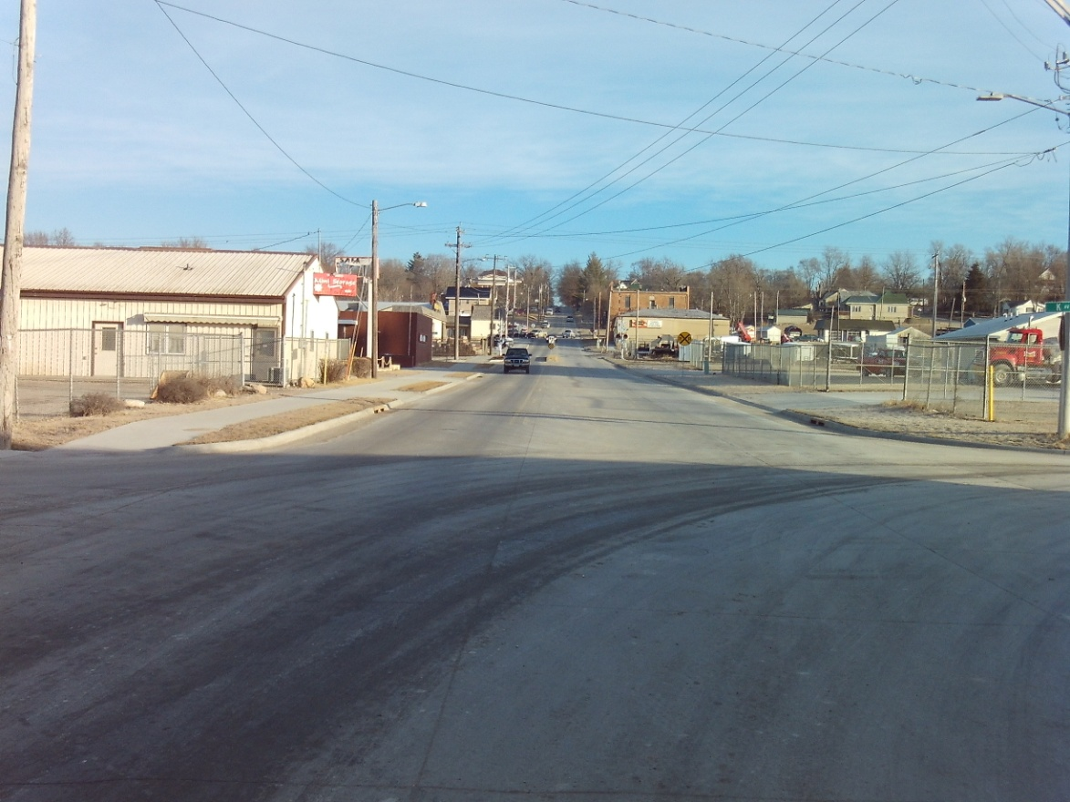
Street Reconstruction/Resurfacing
1.) Full Width, Full Depth PCC Reconstruction Projects
After
Before

Slide 19
Street Reconstruction/Resurfacing
2.) Hot Mix Asphalt Overlay Projects
Hot Mix Asphalt Overlay projects typically include:
- Milling existing street surface
- Laying base layer
- Laying surface layer
- No underground work
- Minimal/No subbase preparation
- 15 year design life

Slide 20
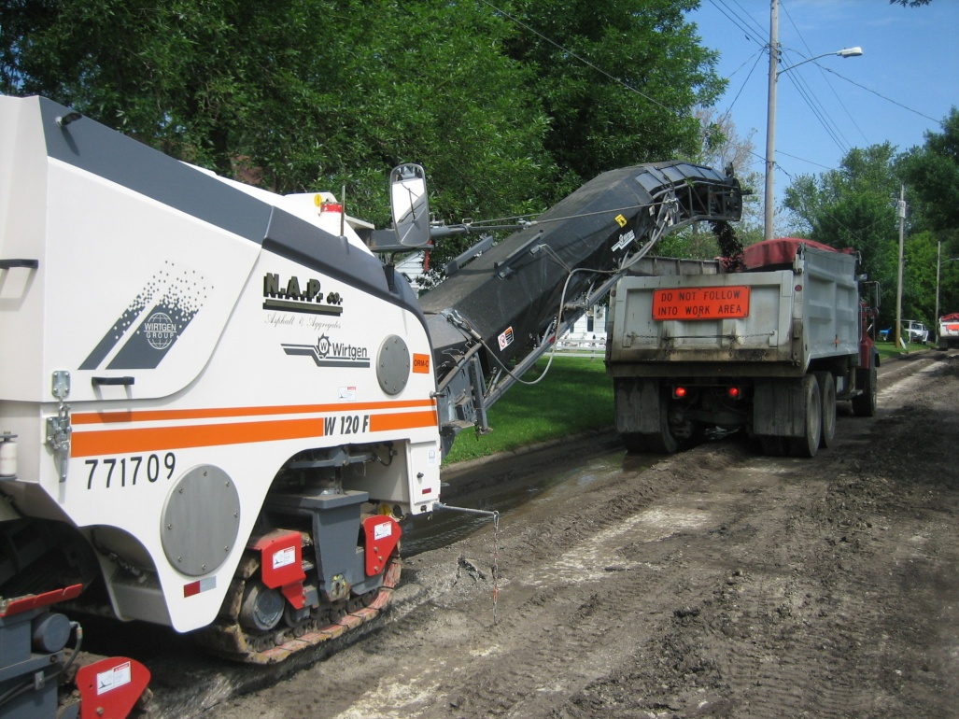
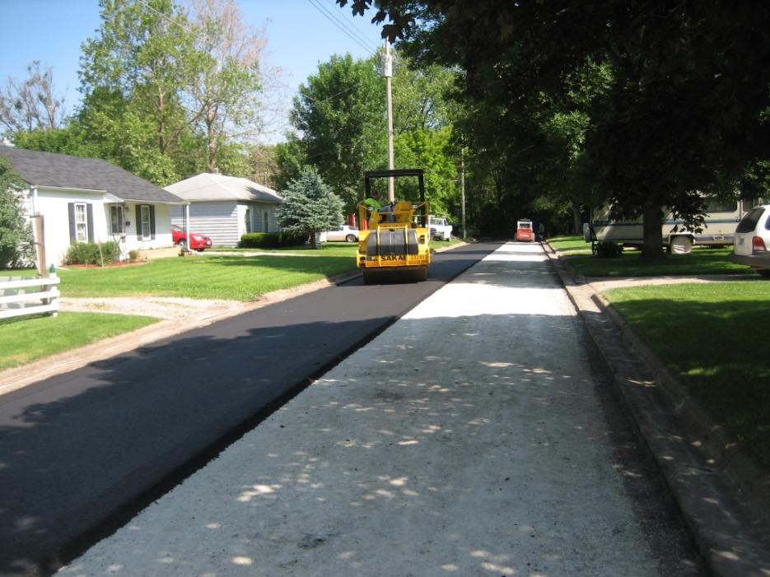
Street Reconstruction/Resurfacing
2.) Hot Mix Asphalt Overlay Projects

Slide 21
Street Reconstruction/Resurfacing
2.) Hot Mix Asphalt Overlay Projects
After
Before

Slide 22
Thank You

